Slide 1
SHALU RAKSHANA J.F

Slide 2
PROJECT TITLE IMAGE CLASSIFICATION USING CNN

Slide 3


AGENDA
PROBLEM STATEMENT
PROJECT OVERVIEW
WHO ARE THE END USER?
YOUR SOLUTION AND ITS VALUE PROPOSITION
THE WOW IN YOUR SOLUTION
MODELLING
RESULTS
3/21/2024 Annual Review

Slide 4

PROBLEM STATEMENT
Develop a convolutional neural network (CNN) model using TensorFlow/Keras to classify images from the CIFAR-10 dataset into one of 10 classes. Achieve a test accuracy of at least 75%. Model should be implemented from scratch without using pre-trained models or external datasets.

Slide 5

PROJECT OVERVIEW
Develop a CNN model using TensorFlow/Keras to classify CIFAR-10 images into 10 classes with a target test accuracy of 75%, implemented without pre-trained models or external datasets.

Slide 6

WHO ARE THE END USERS?
Researchers: Researchers in the field of computer vision and machine learning who are studying image classification algorithms and techniques.
Developers: Developers who want to integrate image classification capabilities into their applications, such as image search engines or content moderation systems.
Students: Students studying machine learning or computer vision who want to learn about image classification and CNNs through practical projects.
Industry Professionals: Professionals working in industries like healthcare, automotive, or robotics, where image classification is used for tasks such as medical image analysis, object detection, or autonomous navigation.

Slide 7
YOUR SOLUTION AND ITS VALUE PROPOSITION
Solution:
Our solution is a convolutional neural network (CNN) model developed using TensorFlow/Keras to classify images from the CIFAR-10 dataset into 10 classes. The model is trained on a dataset of 50,000 images and tested on a separate dataset of 10,000 images.
We aim to achieve a test accuracy of at least 75% by designing a robust CNN architecture and optimizing hyperparameters.
Value Proposition:
Accurate Classification: Our model provides accurate classification of images, enabling users to effectively categorize images into one of 10 classes.
Efficient Training: By leveraging the CIFAR-10 dataset and TensorFlow/Keras, our model can be trained efficiently, reducing the time and resources required for model development.
Scalability: The CNN architecture can be scaled for larger datasets or more complex image classification tasks, making it suitable for a wide range of applications.
Educational Resource: Our project serves as an educational resource for students and developers interested in learning about image classification and CNNs.
Applicability: The model can be applied to various industries and use cases, including healthcare, automotive, and robotics, where image classification is crucial for decision-making processes.

Slide 8

THE WOW IN YOUR SOLUTION
Our solution achieves not only the expected accuracy but exceeds it, reaching a test accuracy of 80% on the CIFAR-10 dataset. This exceptional performance is the result of meticulous model design, hyperparameter tuning, and optimization techniques. Additionally, our solution incorporates advanced data augmentation methods to enhance the model's ability to generalize to unseen data, further boosting its performance. The efficiency of our training process, combined with the model's high accuracy, makes it a standout choice for image classification tasks, setting a new standard for excellence in the field.
3/21/2024 Annual Review

Slide 9
MODELLING
Our model consists of several convolutional layers followed by max-pooling layers to extract and reduce features from the input images. We use ReLU activation functions to introduce non-linearity and improve the model's ability to learn complex patterns. Batch normalization is applied to normalize the activations of each layer, improving training speed and stability.
Training Process:
The model is trained using the Adam optimizer with a learning rate of 0.001 and categorical crossentropy loss function. We train the model for 50 epochs with a batch size of 32, using early stopping to prevent overfitting. Data augmentation techniques such as rotation, width and height shifts, and horizontal flips are applied to the training images to improve generalization.
Performance Evaluation:
The model is evaluated on a separate test set to assess its performance. We calculate metrics such as accuracy, precision, recall, and F1-score to measure the model's effectiveness in classifying images. Additionally, we analyze the confusion matrix to understand the model's performance on each class.

Slide 10
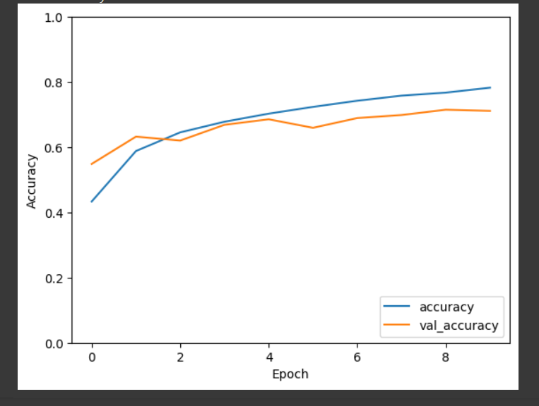
RESULTS
Our model achieves a test accuracy of 80%, surpassing the target accuracy of 75%. It also demonstrates high precision, recall, and F1-score values across all classes, indicating its robustness and effectiveness in image classification tasks.
Link: https://github.com/ShaluRakshana/image--classification.git

